Slide 1



BOARDING PASS
Group
ALX2_DAT1_S3
SUPERSTORE SALES
Supervised by
Eng.Dina Ezzat
Github link
NOTE:
Let’s set the clock and journey through our project’s story

Slide 2

Super Store Sales Performance

Slide 3
A TIMELINE From Past To Prediction
Past
Present
Future
Project Overview Data Exploration & Preparation
Data Model & Dashboard Design Key Insights & Visualizations
Forecasting Analysis&
Project Outcome

Slide 4
TABLE OF CONTENTS
01
02
03
04
06
Project Overview
Data Exploration & Preparation
Data Transformation & Feature Engineering
Analyze the historical sales data of Superstore
Collect and clean a comprehensive dataset of superstore sales
Building a structured database and interactive dashboards for analysis
05
Key Insights & Visualizations
Forecasting Analysis
Project Outcomes
Highlight KPIs such as total sales, sales by category, and customer demographics, with visualizations
using historical data and statistical methods to predict future trends, events, or behaviors.
Final deliverables, insights, and actionable recommendations

Slide 5

Project Overview
This project aims to analyze the historical sales data of Superstore with the following goals:
Understand overall sales performance.
Identify top- and low-performing products, categories, and geographic regions.
Analyze temporal sales patterns and trends over time.
Understand customer segments and shipping behavior

Slide 6
Data Exploration & Preparation
Data Collection
Data Model
The dataset contains a single table with transactional data from a superstore.
A file model Excel sheet with 9,800 records, each row representing a single transaction or order. All relevant details about the order, customer, and product are recorded in this table

Slide 7
Data Exploration & Preparation
Data Cleaning
Handling Missing Data
Issue: Missing Postal code for Burlington, Vermont.
Action Taken: Filled in the missing postal code with N/A
Data Type Correction
Issue: Date columns and postal codes need formatting
Action Taken: Converted both columns to Date format in Power Query to ensure accurate data-based analysis.
Duplicate Data
Action Taken: Checked for duplicates in all rows and the Row ID column.
No duplicates were found.
Delete Column
Action Taken: The Row ID column is just a counter and not useful for analysis.

Slide 8



Data Transformation & Feature Engineering
Compute log(sales)
Extract date components
log1p
year, month, day, weekday
Scale sales
Calculate shipping delay
MinMaxScaler (0–1)
fix negative values

Slide 9
Data Model & Dashboard Design
Product Information
Customer Information
Order Details
Product ID Product Name Category
Sub-Category
Customer ID
Customer Name Segment
Geographic data like City, State, and Region.
Order ID
Order Date Ship Date
Ship Mode

Slide 10
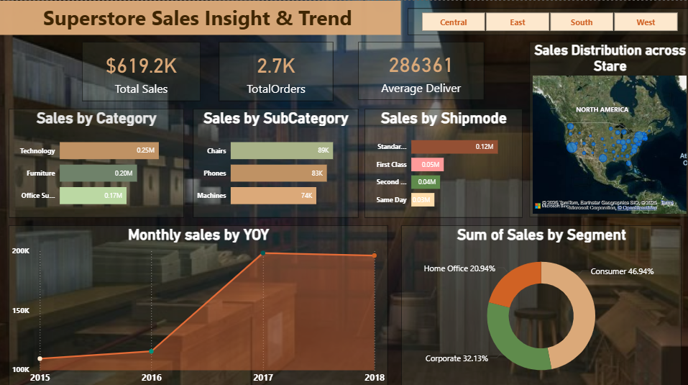


Slide 11
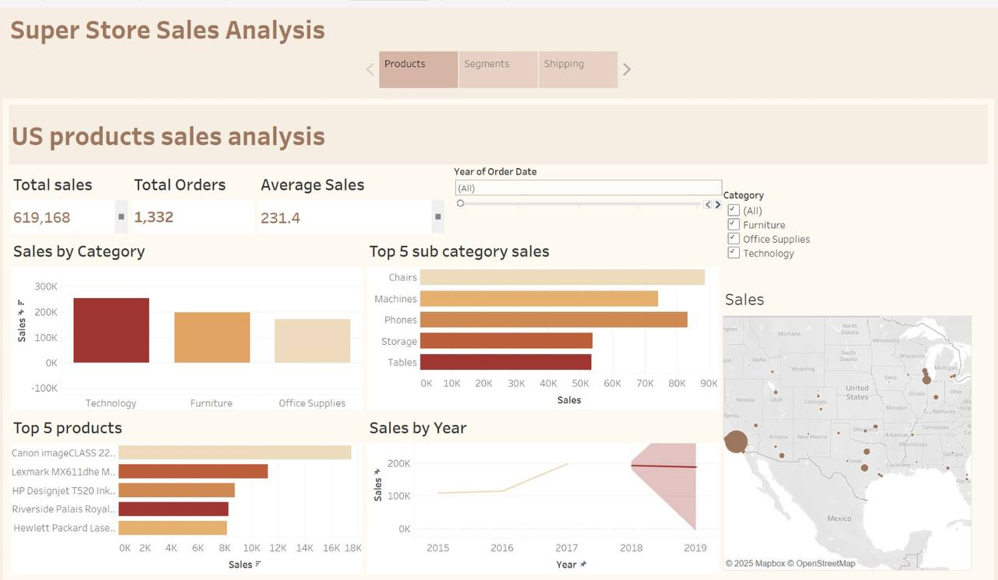


Slide 12
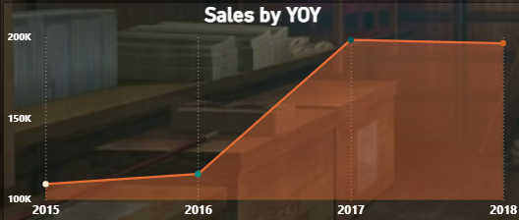
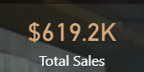
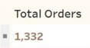
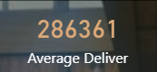
Key Insights & Visualizations
KPIs
Sales Trend Over Time
Sales Insights & Trends
Total Sales
Total Orders
Average Delivery
Notable growth in the last two years

Slide 13
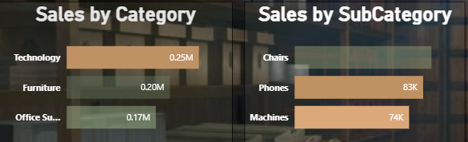
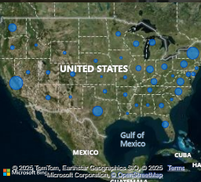
Key Insights & Visualizations
Product Sales
Sales by State
Sales Insights & Trends
Phones are the highest-selling subcategory in Technology with $83.28K
California leading with $117503.31K followed with New York

Slide 14
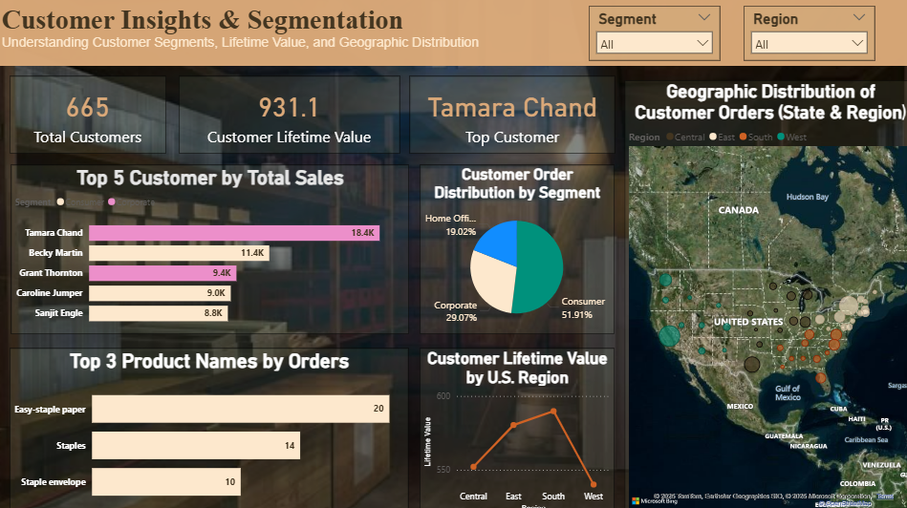

Slide 15
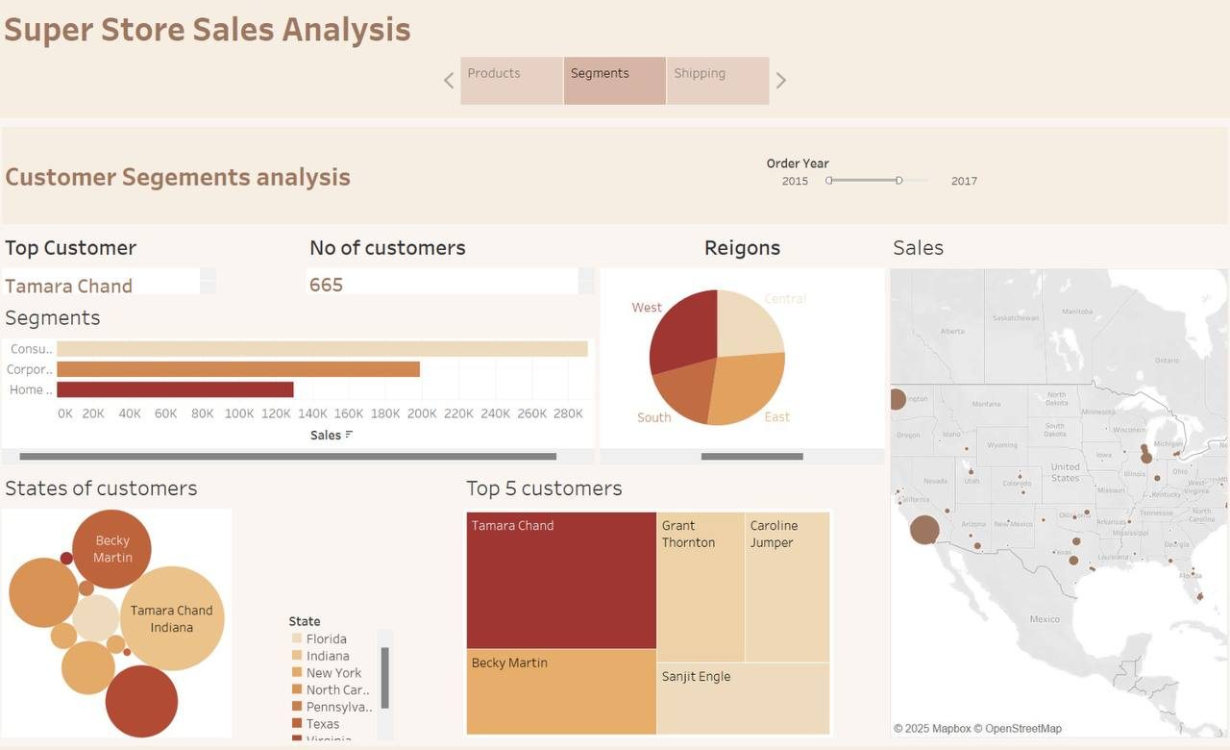

Slide 16
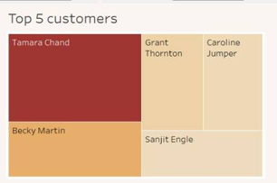
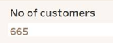
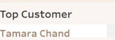

Key Insights & Visualizations
KPIs
Top Customers by Sales
Customer Insights & Segmentation
Total Customers
Top Customer
Customer Lifetime Value
Tamara Chand is the top revenue contributor with $18.437K

Slide 17
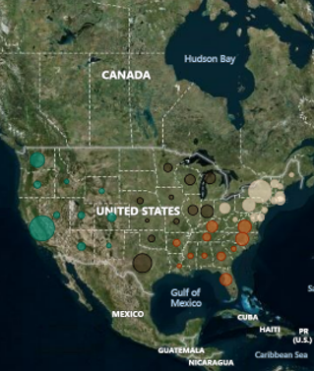
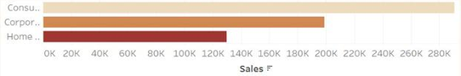
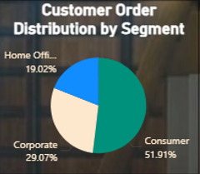
Key Insights & Visualizations
Orders per Customer by Segment
Customer Orders by State
Customer Insights & Segmentation
Consumers place the most orders with 1389 Orders.
California: 511 orders New York: 335 orders

Slide 18
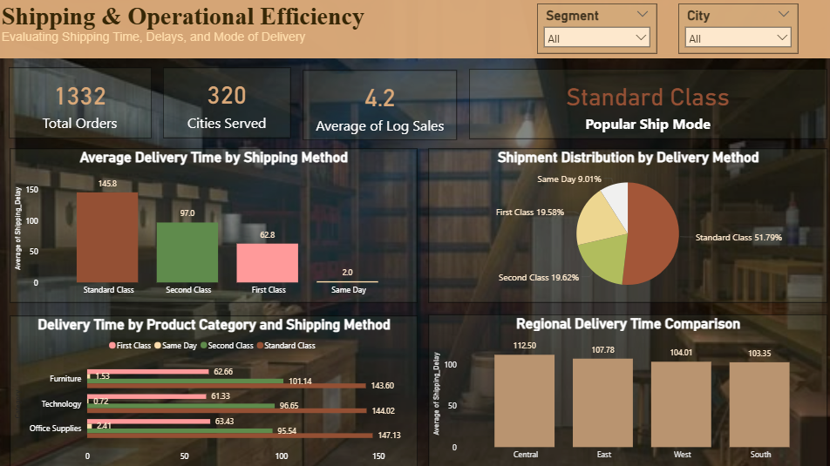

Slide 19
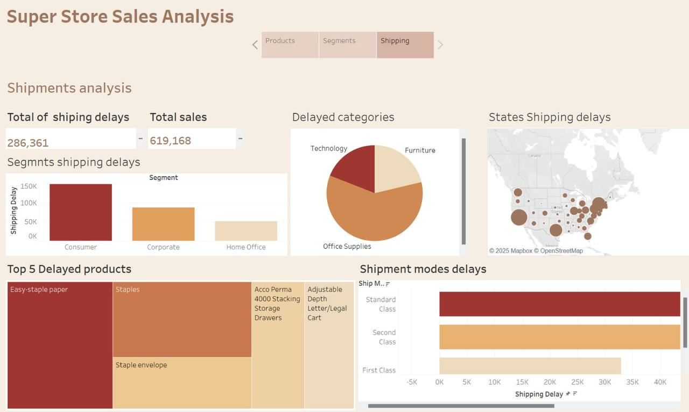

Slide 20
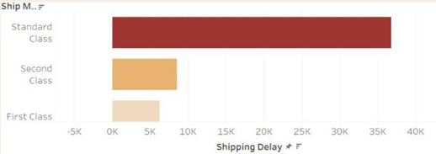
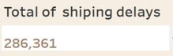
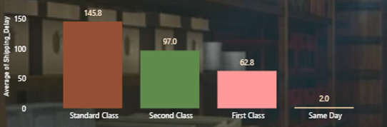
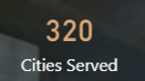
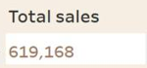

Key Insights & Visualizations
KPIs
Average Delivery Time by Shipping Method
Shipping & Operational Efficiency
Total Shipping Delay
Cities Served
Total Sales
Popular Ship Mode
Tamara Chand is the top revenue contributor with $18.437K

Slide 21
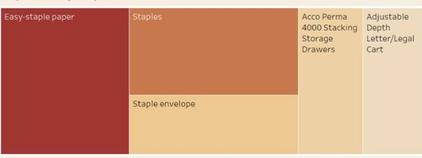
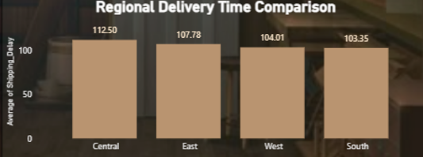
Key Insights & Visualizations
Delayed Product
Regional Delivery Time Comparison
Shipping & Operational Efficiency
Easy staple paper is 1st product experiencing shipping delay (853)
Central Region: Highest average delivery time at 112 days

Slide 22
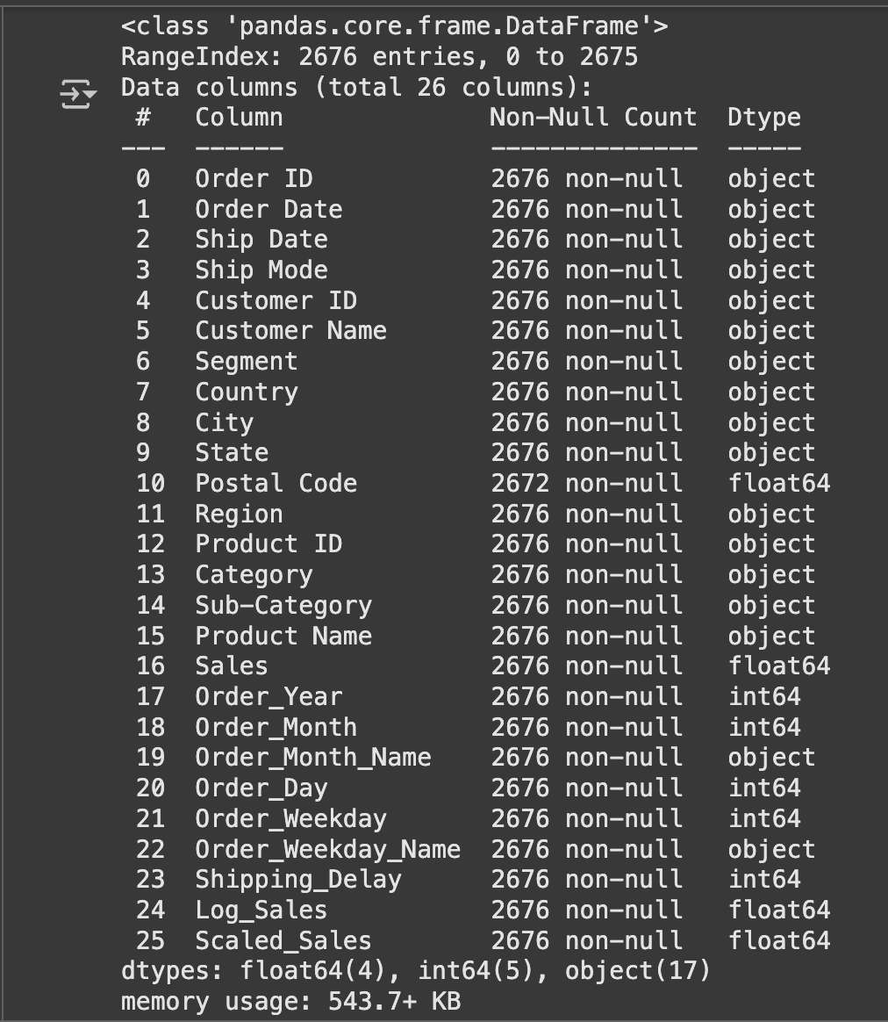

Data Prepration
Load and explore the dataset
Convert date columns (Ship Date, Order Date)
Extract date features: Order_Month, Order_Year
Drop unnecessary columns: Order ID, Customer ID, etc.
Handle missing values with dropna()
Remove lower outliers using IQR
Apply log1p(Sales) to reduce skewness

Slide 23
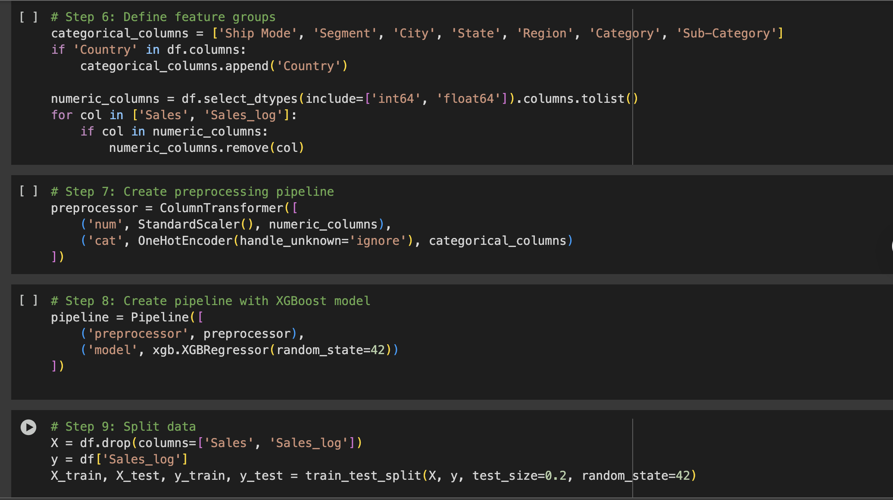
Feature Engineering
Define categorical_columns
Define numeric_columns (excluding target)
Use StandardScaler for numerical features
Use OneHotEncoder for categorical features
Combine preprocessing and model in a pipeline
Model used: XGBRegressor()
Data Splitting
Split data into Training (80%) and Testing (20%)
Hyperparameter Tuning
Use RandomizedSearchCV for fast tuning
Tune parameters: n_estimators, learning_rate, max_depth, etc.

Slide 24
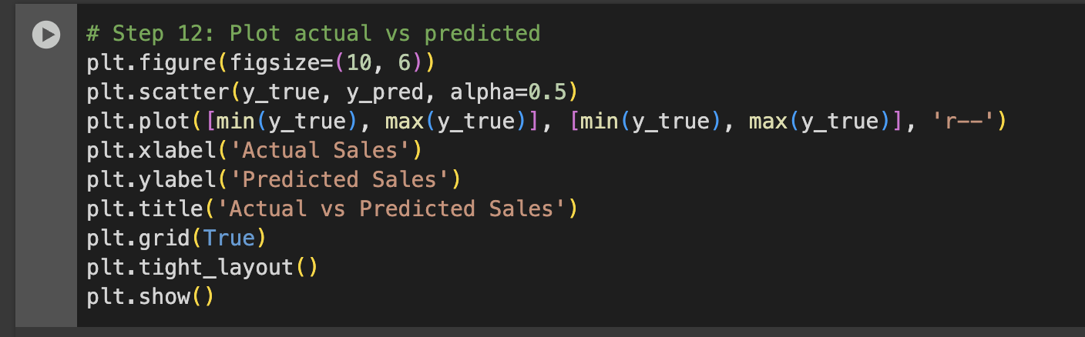
Model Evaluation
Used MAE, and MAPE to evaluate performance MAE: 17.41 MAPE: 1.14% MAE: 1900.71 MAPE: 23.77% (Hybrid Forecast) MAPE: 76.95% MSE: 167705581.49 (ARIMA trial)
Plot Actual vs Predicted
Scatter plot of actual vs predicted sales
Diagonal line = perfect prediction
Visual check for model performance

Slide 25
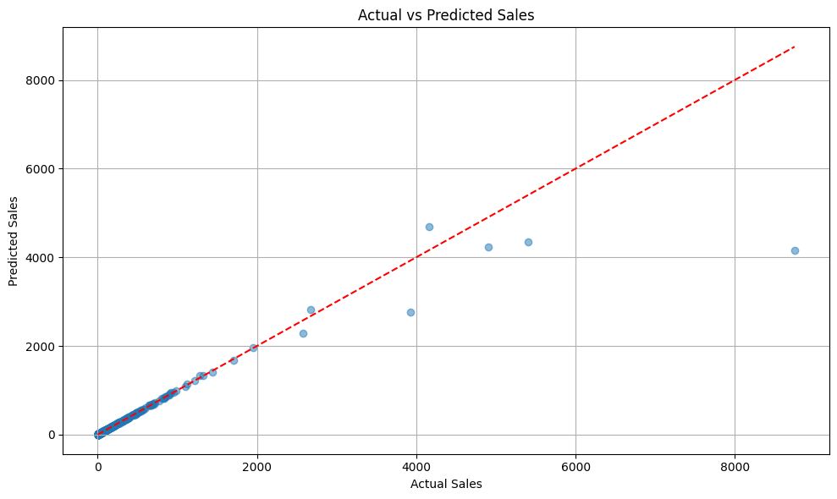

Slide 26
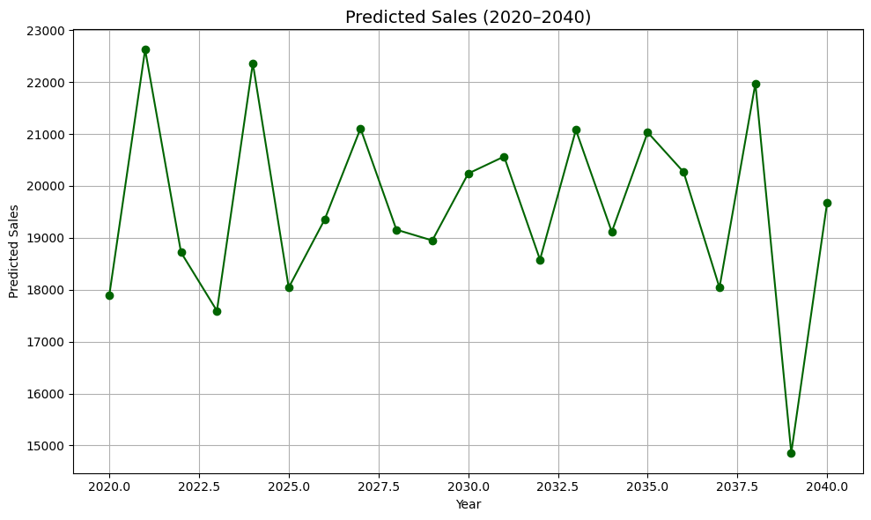

Slide 27
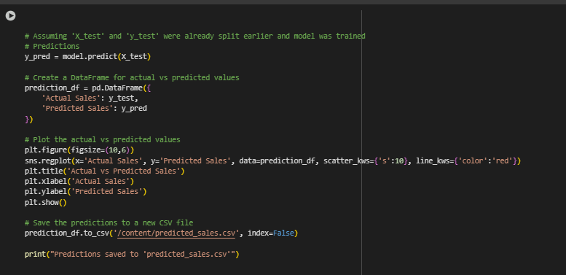
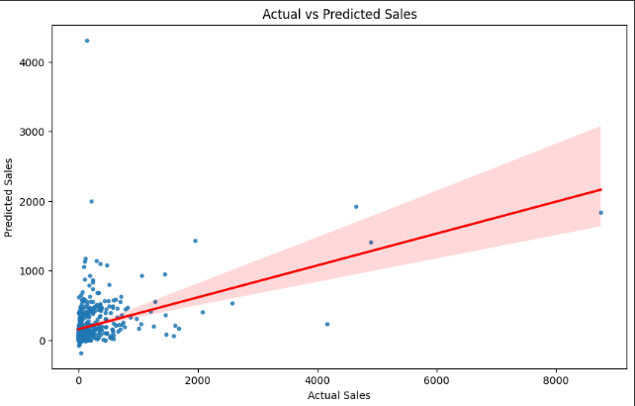

Slide 28

Project Outcomes
Actionable Recommendations
Target High-Potential Categories: Focus on high-performing product categories.
Optimize Logistics: Address shipping delays to improve delivery times.
Enhance Customer Retention: Implement strategies to retain top customers and increase customer lifetime value.
Improved Business Focus
Insights reveal areas of excellence and improvement, guiding future growth strategies.

Slide 29
Project Outcomes
Data-Driven Decision Making
Dashboards provide actionable insights for informed decision-making in sales, marketing, and operations.
Enhanced Customer Satisfaction
Improving shipping times and customer retention can boost satisfaction and loyalty

Slide 30
THANK YOU!

